Slide 1
Health Equity: Moving Beyond the Legacy of Racism & Discrimination
Association of University Programs in Health Administration
June 19, 2020

Slide 2
Objectives
Define health equity and inequity (health disparities);
Review the role of systemic racism and discrimination in health disparities;
Discuss the legacy of racism in healthcare;
Describe educational strategies for systemic changes that promote health equity.

Slide 3
http://healthypeople.gov/2020

Slide 4
EQUITY
Assurance that all members of society have the opportunity for health – a sense of well-being and the ability to lead full, productive life-
Regardless of SES, race/ethnicity, gender, sexual orientation, etc. or other social factors that might contribute to inequity

Slide 5
INEQUITY
Systemic issues affect groups to create the conditions that lead to differences in risk for a number health conditions and behaviors, these are the social determinants of health.
According to the World Health Organization:
Social determinants are:
“The conditions in which people are born, grow, live, work and age. These circumstances are shaped by the distribution of money, power and resources at global, national and local levels.”

Slide 6
Disparities
We see these disparities in:
educational outcomes
income
employment
legal and judicial outcomes
health
These differences are symptoms with a common root cause.
This acknowledgement does not lead to solutions, but sets the context of our discussion.

Slide 7
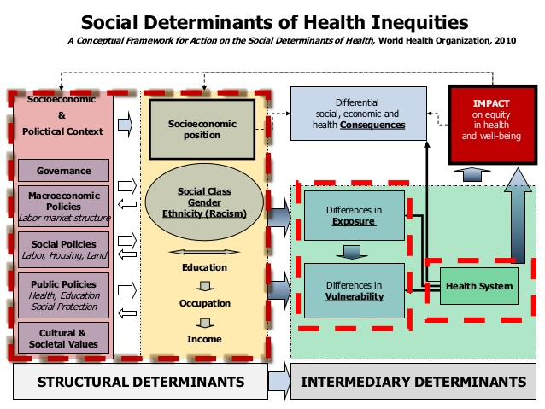

Slide 8
Disparities in Health & Healthcare
Documentation of the Existence
Disease
Stroke
Cancer
HIV infection and AIDs
Care
Cardiovascular care
Cancer care
Mental Health Services
Receipt of Immunization for flu & pneumonia
Renal disease and kidney transplant

Slide 9
Benjamin Rush, MD, signer of the Declaration of Independence, Dean of the Medical School at the University of Pennsylvania, "Father of American Psychiatry”
“Negroes suffered from Negritude, a mild form of leprosy.
The only cure was to become white.
Dr. Rush was a leading mental health reformer and co-founder of the first anti-slavery society in America.
Dr. Samuel Cartwright, a prominent Louisiana physician, leading authority on the medical care of Negroes (1851).
Drapetomia: running away, sulky and dissatisfied behavior should be whipped-strictly as a therapeutic early intervention.
Dysaethesia Aethiopica: rascality, cured by whipping

Slide 10
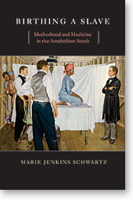
Fistula Surgery & James Marion Sims, M.D.

Slide 11
Early Reproductive Research: Why Black Women?
“. . . it is most improbable that Sims and [his assistant] Bozeman could have established so remarkable a surgical schedule without the slave system which provided the experimental subjects.”
— Walter Fisher
Slaves were convenient, but there was also the racist ideology that fed
erroneous beliefs about Black women: sexually aggressive; bad
mothers; rise after labor’; impervious to pain

Slide 12
The Mythology of Pain in 19th- century Scientific Racism
“When we come to reflect that all the women operated upon in Kentucky, except one, were Negresses and that these people will bear anything with nearly if not quite as much impunity as dogs and rabbits, our wonder is lessened.” — Dr. James Johnson, editor of the London Medical and Chirurgical Review,
“[Blacks] bear surgical operations much better than white people and what would be the cause of insupportable pain for white men, a Negro would almost disregard. . . . [I have] amputated the legs of many Negroes, who have held the upper part of the limb themselves.”
—Dr. Charles White

Slide 13
In the late 1960s, Vernon Mark, William Sweet and Frank Ervin:
Suggested urban violence, which many perceived as a reaction to oppression, poverty & economic discrimination was due to "brain dysfunction”.
Recommended the use of psychosurgery to prevent outbreaks of violence.
Biological and genetic discussions of violence in black and brown people continue today.

Slide 14
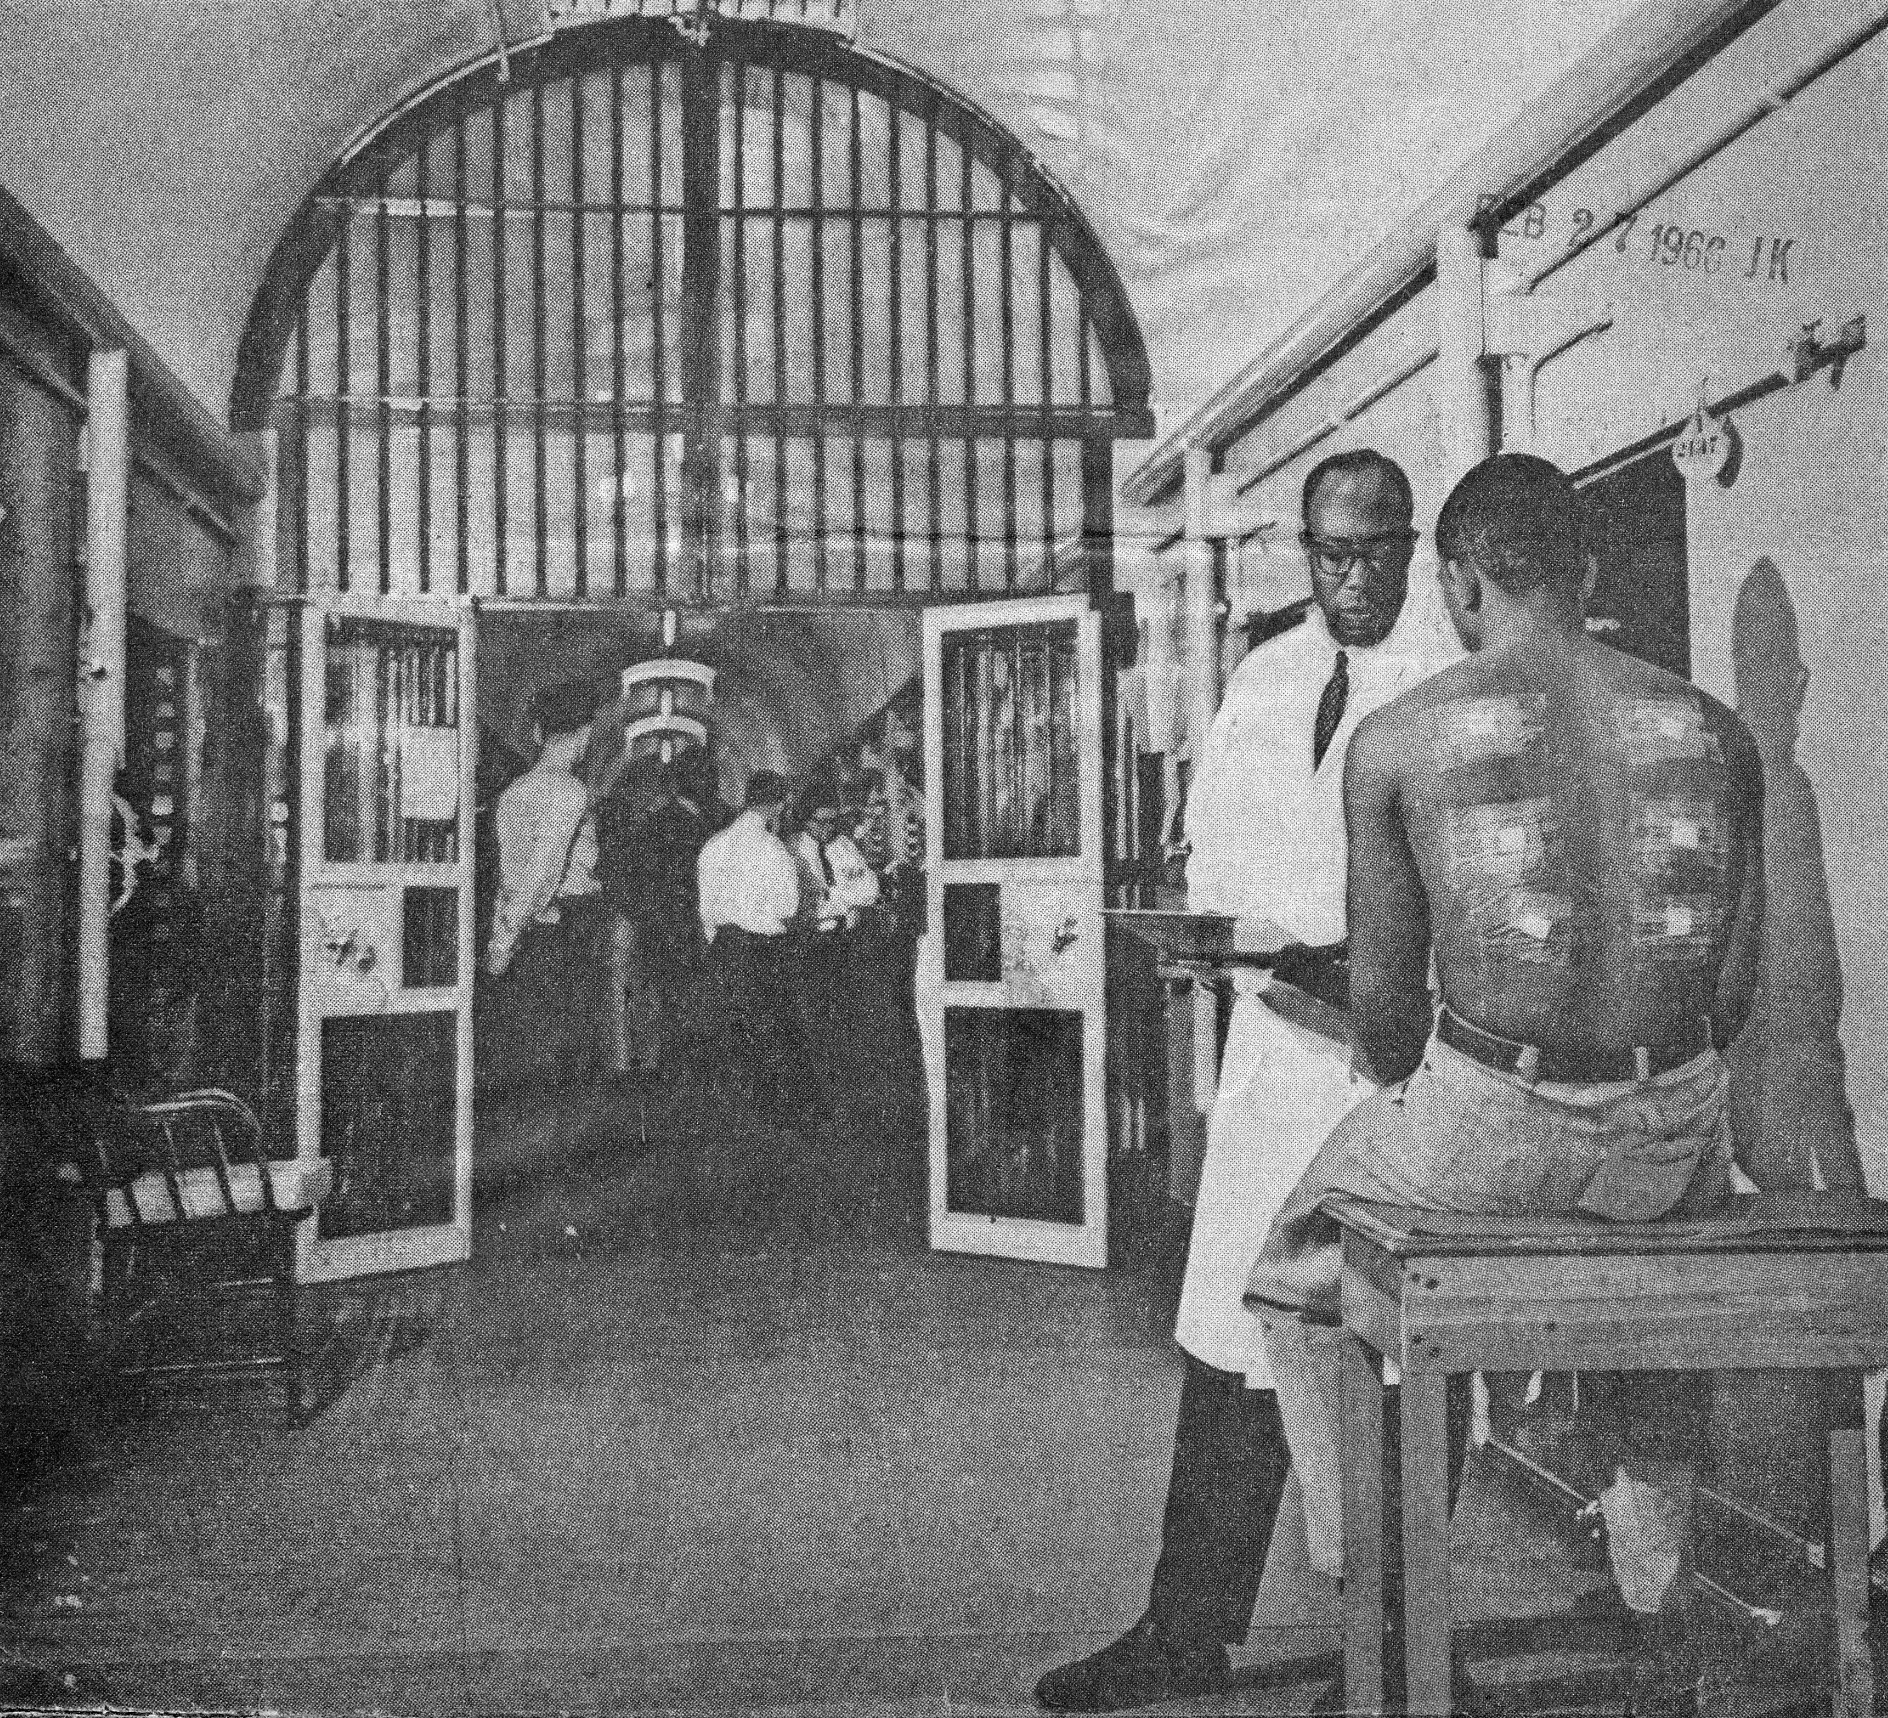
Solomon McBride and subject
Albert Kligman, MD
It was cheaper to use niggers than cats, because they were everywhere and cheap experimental animals . —Harry Bailey, M.D., c. 1977
50 lobotomies of blacks at Alabama’s Almoree prison; additionally, at Durham N.C., Long Beach, California, Minneapolis and Syracuse, N.Y. prisons
Austin Stough’s research led to many participants contracting hepatitis
Many other studies: Cancer-cell implantation, testicular irradiation, malaria

Slide 15
Segregation in Healthcare
Hill-Burton Act (1946): Truman Initiative resulted in the construction of numerous healthcare facilities also codified the idea of "separate but equal" in hospitals and health care facilities.
This aspect of the law was overturned in a federal court challenge in 1963 (Simkins v Moses H. Cone Memorial Hospital), nine years after Brown vs Board of Education of Topeka.
1963 - AMA urges Congress to amend the Hill-Burton hospital construction act such that “participation of a private hospital in the Hill-Burton program does not in any way change the private character of the hospital in any respect other than outlawing” racial discrimination.

Slide 16
Segregation in Healthcare
1965 - Approximately 200 black and white demonstrators (Medical Committee for Human Rights and NMA) picketed the AMA annual meeting the AMA.
Call to “Integrate All County and State Medical Societies!” and “End Discrimination in Medicine Now!”
Cypress v Newport News Hospital Association (1967), reaffirmed the federal government’s use of Medicare certification guidelines to force hospitals to open up patient admissions, education programs, and staff privileges regardless of race, color or national origin.

Slide 17
Implicit Bias
Patients have the least positive affect and satisfaction with physicians relatively low in explicit but high implicit bias.
Seen as deceitful
Most positive interaction is low implicit and low explicit.
Little difference in high explicit, low implicit and high explicit, high implicit.

Slide 18
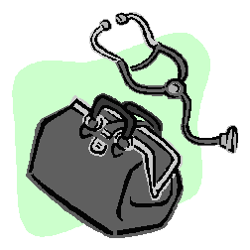
Bias in Healthcare Interactions
Explicit Bias – blatant discrimination
Self-reported, conscious
Predicts physicians’ reactions to the patient encounter.
Not a good measure of the patient’s reaction

Slide 19
Errant Beliefs About Black Health
2016 study, Hoffman et al. conclude: “white laypeople and medical students and residents [held] false beliefs about biological differences between blacks and whites. . . . racial bias in pain perception is associated with racial bias in pain treatment recommendations.”
Some differences in treatment are the result of in group favoritism. People of color may receive less treatment for pain, but white Americans are possibly over treated. Data suggest that white children are more likely to receive antibiotics.

Slide 20
Study focused on medical mistrust:
47.8% reported experiences with behavior that they considered demeaning, dismissive, unfair and/or discriminatory within a medical setting.
18.2% - based on race alone
12.1% - based on SES
60.6% - based on race and either sex or SES
Most frequent offenders:
Nurses and Office Staff
Incidents:
Overheard offensive comments, jokes, remarks
Provided insufficient time to address concerns, information needs
Unsupportive
Felt responses demeaned or degraded

Slide 22
Resolution
Awareness and recognition of grievances that are communicated
Requires compassion in response
Organized systemic approach to grievances, with input from those affected
Process, actions and results communicated

Slide 23
Public Participation
Public participation assumes that those who are affected by a decision have a right to be involved in the decision-making process.
Requires
Two-way communication
Collaborative problem solving
Attempts to obtain better and more acceptable decisions.
NIH Council of Public Representatives
Notes:
23

Slide 24
Enhanced Culturally & Linguistically Appropriate Standards (CLAS)
15 Standards that instruct individuals and organizations on how to implement & maintain culturally and linguistically appropriate services.
All 15 Standards are necessary to advance health equity, improve quality, and help eliminate health care disparities.

Slide 25
CLAS Standards
The Principal Standard
Provide Effective, Equitable, Understandable & Respectful Quality Care & Services
Standard 1 is the principal standard because the ultimate aim in adopting the remaining Standards (2- 15) is to achieve Standard 1.

Slide 26
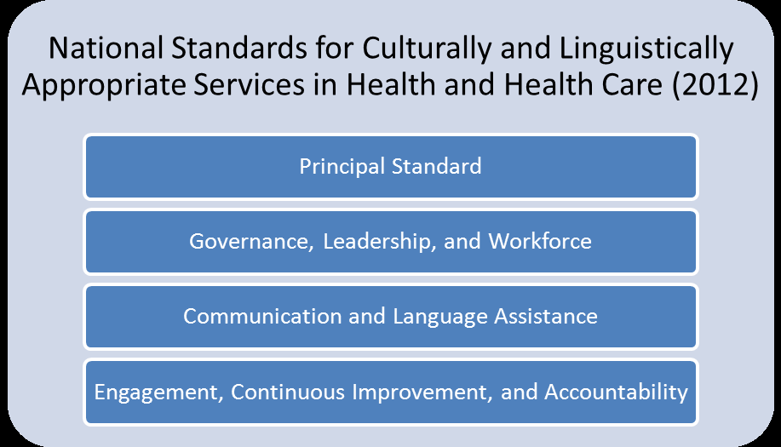

Slide 27
Interaction Institute Artist: Angus McGuire

