Slide 2
David A. Winston Health Policy Fellowship Deadline - October 17, 2022

Slide 3
History of the Winston Fellowship
The Fellowship commemorates the contributions and personal qualities of David A. Winston who, for 20 years, played a significant role in shaping American health policy.
David Winston served as a bridge between the public sector, which he knew well from long experience, and the private sector, in which he deeply believed. His advice and counsel were sought and accepted by leaders in both sectors and his knowledge and integrity earned him the respect and trust of the healthcare community.
Notes:
Kerry

Slide 4
Fellowship Program
The objective of the Fellowship is to provide a unique opportunity to learn about the political system through direct exposure to public and private sector roles in health policy development.
The Fellowship is a 12-month postgraduate experience in Washington, DC.
.
Key Values:
Bipartisanship: Commitment to engage on all sides of the aisle
Public/private partnerships: Appreciation for bridging the two sectors
Demonstrated health policy interest: Passion for an area in health policy
Engagement: Eagerness to learn
Notes:
janhavi

Slide 5
Timeline of Fellowship
Phase I: Three months
Informational Interviews
Educational series
Meet with mentors
Domestic field trips (e.g., CDC, Commonwealth Fund, Boston health providers)
Conferences
Phase II: Nine months
Full-time placement working on health policy in DC
Attend Winston events (e.g., Health Policy Ball, Scholar Symposium)
Notes:
janhavi

Slide 6
Phase I: Summer Interviews
Private Sector Industry
Health insurance, pharmaceutical, and medical device companies (e.g., Blue Cross Blue Shield)
Trade Associations
E.Gg., American Medical Association, America's Essential Hospitals
Research and Academic Groups
E.g., Urban Institute, Kaiser Family Foundation, Georgetown University
Systematic exposure to key health policy groups representing all sectors and perspectives
Congress
United States Senate and House offices and committees (e.g,. Senate Finance, Ways & Means)
Administration
The White House and Executive Branch agencies (e.g., CMS, HRSA)
Notes:
Jessica

Slide 7
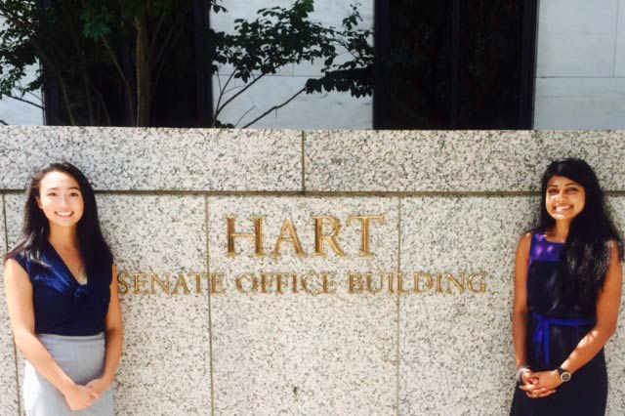
Phase II: Fellowship Placement
Pursue a full-time placement to gain first-hand experience in policy making, with the guidance of the Winston Board of Directors.
Past Placements:
U.S. Senate Finance Committee
U.S. House Ways & Means Committee
Center for Medicare & Medicaid Services, CMMI
Department of State
Office of Senator Nancy Pelosi
Notes:
Jessica

Slide 8
Fellowship Benefits
Annual Salary, $55,000
Medical and Vision Insurance, Covered
Moving Expenses, $2,500
Conference Fees and Travel Expenses, $5,000
Monthly Metro, $200 during the appointment phase (June-August), $100 during your Placement.

Slide 9
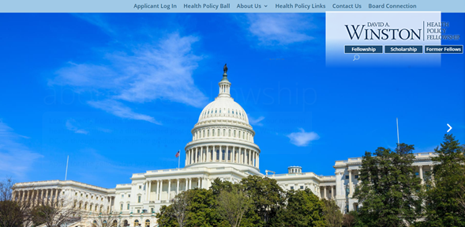
Application Process
More information on the programs and applications process can be found at www.winstonfellowship.org or email info@winstonfellowship.org.
Notes:
janhavi

Slide 10
Additional questions?
Contact:
Kerry McAteer, Chief Operating Officer
kmcateer@winstonfellowship.org
Notes:
janhavi

