Slide 1
David A. Winston Health Policy Scholarship

Slide 2
History of the Winston Fellowship
The Fellowship commemorates the contributions and personal qualities of David A. Winston who, for 20 years, played a significant role in shaping American health policy.
David Winston served as a bridge between the public sector, which he knew well from long experience, and the private sector, in which he deeply believed. His advice and counsel were sought and accepted by leaders in both sectors and his knowledge and integrity earned him the respect and trust of the healthcare community.
Notes:
Kerry

Slide 3
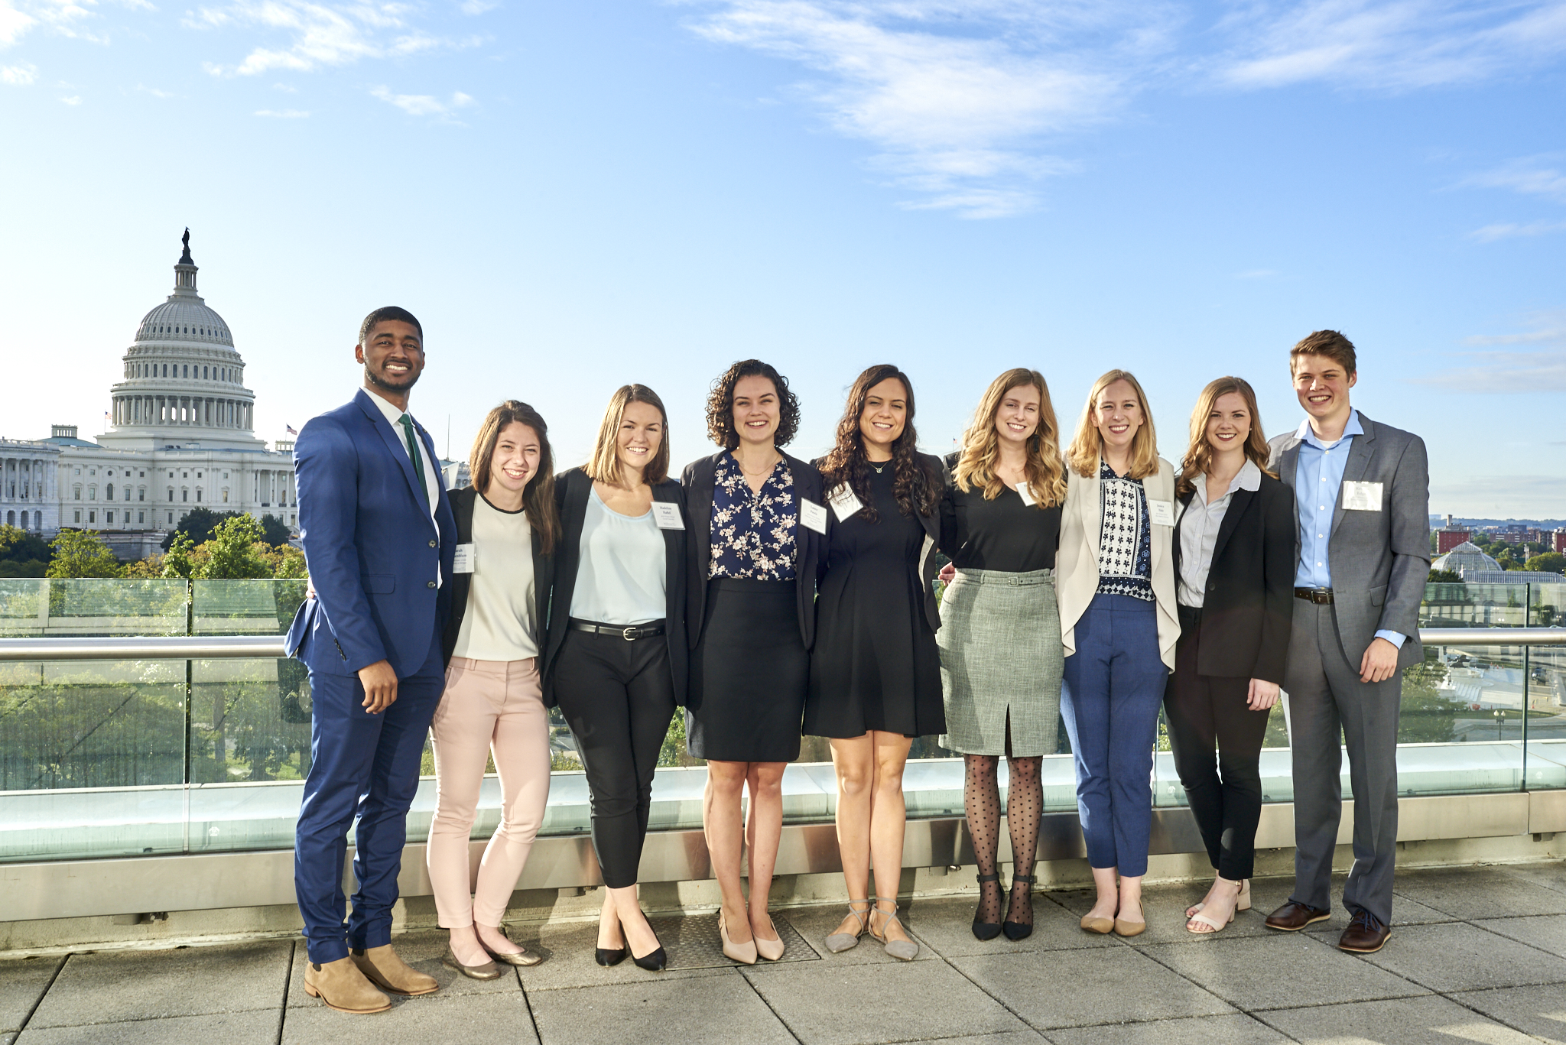
Scholarship Deadline March 7, 2022

Slide 4
Scholarship Program
The scholarship program recognizes student excellence and achievement based upon that student’s record and recommendations from faculty and colleagues.
Up to twenty awards of $10,000 will be offered to each selected student who demonstrates their potential to succeed in health policy, health administration, and/or health management at either the state or national level upon graduation from their degree program.
This program is open to any student enrolled in an academic graduate program at an accredited college or university.
Deadline is March 7, 2022.
Notes:
Kerry (+jess since she was a scholar?)

Slide 5
Scholarship Eligibility Requirements
Applicants must be scheduled to complete the didactic portion of their degree not later than December of the year following the awarding of the scholarship.
U.S. citizenship is required.
Applicants from health policy, public policy, health administration, business, economics, and law graduate programs (e.g. MPH, MPP, MHA, MBA, MA, JD) as well as joint degree programs (e.g. JD/MPH) are strongly encouraged to apply.
In honoring the legacy of David Winston, students of all political ideological perspectives are encouraged to apply.
Notes:
Kerry (+jess since she was a scholar?)

Slide 6
Scholar Symposium
The Winston Symposium brings together the current Winston Scholars, current and former Winston Fellows, the Winston Board, as well as invited health policy makers from Washington. In an informal, day-long session, Winston scholars have the opportunity to test what they have learned by interacting with some of the nation’s experts in health policy.
Recent agenda topics include:
“Health Policy & the Elections: What does public opinion polling tell us”
“The Executive Branch, Crafting and Implementing Policy Change”
“Congress and Health Policy Issues”
“Key Constituencies in Health Policy”
Notes:
kerry

Slide 7
David A. Winston Health Policy Fellowship

Slide 8
Timeline of Fellowship
Phase I: Three months
Informational Interviews
Educational series
Meet with mentors
Domestic field trips (e.g. CDC, Commonwealth Fund, Boston health providers)
Conferences
Phase II: Nine months
Full-time placement working on health policy in DC
Attend Winston events (e.g. Health Policy Ball, Scholar Symposium)
Notes:
janhavi

Slide 9
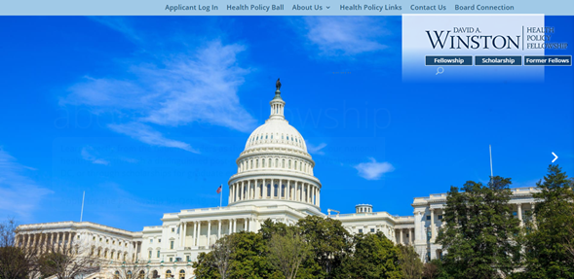
Application Process
More information on the programs and applications process can be found at www.winstonfellowship.org or email info@winstonfellowship.org.
Notes:
janhavi

Slide 10
THANK YOU!
Any questions?
Contact:
Kerry McAteer, Chief Operating Officer
kmcateer@winstonfellowship.org
Notes:
janhavi

Slide 11
Any Questions? Please feel free to ask our speakers about eligibility, applications, the Symposium, Fellowship.
Need additional information? Email info@winstonfellowship.org

