Slide 1
COVID-19 A Wake Up Call For Reinventing & Reimagining Our HealthCare System
Stephen M. Shortell, PhD, MPH, MBA
Blue Cross of California Distinguished Professor
of Health Policy and Management Emeritus
Co-Director, Center for Healthcare Organizational and Innovation Research (CHOIR)
Co-Director, Center for Lean Engagement and Research in Healthcare (CLEAR)
School of Public Health
University of California, Berkeley
Andrew Pattullo Lecture
AUPHA
June 3, 2020

Slide 2
Outline
Introductory Comments
Impact on the Delivery System
Responses to the External Shock – Transitory or Permanent?
Some Lesson from Management Research
Is There Need for a Radically New and Different Way of Leading
and Managing Our Nation’s Health Care Organizations?
Concluding Thoughts

Slide 3
“When This Economy Suffers The Next Inevitable Bump. It Will TAKE More Than All The King’s Horses And All The King’s Men to Put The Extant System Back Together Again.”
Gary Filerman. The Pattullo Lecture. Journal of Health Administration Education. Winter, 2019.
What Happened? More Than A Bump – A Shock!
COVID-19

Slide 4
Impact on the Delivery System
Less Revenue for Hospitals and Physician Practices –
Financial Viability Issues
Another Weakness of the Fee-For-Service Payment System
Supply Shortages
Furloughs, Stress, and Burnout
But, Also, A Stimulus for Innovation and Adaptability

Slide 5
Responses to the External Shock – Public Health
And Prevention – Will They Occur?
Global Early Warning System
Re-Vamped National Emergency Preparedness Agency
Regional “Hub and Spoke” Distribution System
Back Up Surge Capacity
Increased, Sustained, Systematic Investment in Public Health
Workforce and Data Infrastructure
Networked with EHR Data Repositories

Slide 6
Responses to the External Shock – The Health Care Delivery System – Will They Be Permanent?
The Need for Universal Health Insurance Coverage
Increased Investment in Primary Care – CPC+
“Whole Person Development Centers”
Increased Telehealth Use – Payment and Regulatory Issues
Changes in Scope of Practice – Practicing at “Top of License”
Advantages for Larger Integrated Health Systems and Medical Groups?

Slide 7
Responses to the External Shock – The Health Care Delivery System – Will They Be Permanent?
Will this Lead to Increased Consolidation and Vertical Integration Going
Forward?
Increased Partnership with Community Based Organizations and Social
Services Sectors – Vulnerable Patients and Communities, Equity Issues
Increased Acceleration of Value-Based, Population Based Payment
Models - Pay to Keep People Well
Focused Attention on Eliminating Structural Racism – One of the Root
Causes of Inequalities in Health and Well-Being

Slide 8
Technologies having the most potential to drive innovation
Telehealth……………………….…92%
Mobile Devices/Wearables…..……64%
Artificial Intelligence…… ……....57%
Patient-Facing Apps………………57%
Source: Modern Healthcare Research, May 11, 2020

Slide 9
Lessons from Management Research
Put People First
Systems Thinking/Learning Mindset to Manage Operations Creatively
Attend to Teamwork and Coordination
Create Effective Outside Partnerships
Embrace Clear and Humble Leadership – Anti-Heroes, “Everyone a
Problem-Solver”, “Deference to Expertise”
Source: Nembhard IM, Burns LR, Shortell SM. Responding to Covid-19: Lessons from Management Research. NEJM Catalyst, April 17, 2020.

Slide 10
Five Behaviors of Effective Leaders
Willingness - Reflection
Humility – Go See
Curiosity – Active Listening, Asking Effective Questions
Perseverance – Buddy System, A Coach
Self-Discipline – Leader Standard Work
Source: Toussaint JS, and Ehrlich SP. Five Changes Great Leaders Make to Develop an Improvement Culture. NEJM Catalyst, April 27, 2017.

Slide 11
Need for a Radically New Leadership and Management System
A Foundation for Sustainable Operational Excellence
The Shingo Principles
The Lean Management System
The Baldrige Framework

Slide 12
A Multi-Level Framework for Change
Four Levels of Change for Assessing Performance Improvement
Assumptions About Change
Reimbursement, legal, and regulatory policies are key
Larger System/ Environment
Organization
Structure and strategy are key
Cooperation, coordination, and shared knowledge are key
Group/ Team
Individual
Knowledge, skill, and expertise
are key

Slide 13
The Shingo Model

Slide 14
The Shingo Principles

Slide 15
The Lean Management System
An overall management/ operating system that uses a continuous improvement culture that empowers front line workers (nurses, physicians, support staff) to solve problems and eliminate waste by standardizing work to improve the value of care delivered to patients.
A socio-technical system approach emphasizing culture, leadership, work design, tools.

Slide 16
The Baldrige Framework
Is Your Organization Doing as Well as it Could?
How Do You Know?
What and How Should Your Organization Improve or Change?
Source: Toussaint JS, Griffith JR, Shortell MS. Lean, Shingo, and the Baldrige Framework: A Comprehensive Method to Achieve a Continuous-Improvement Management System. NEJM Catalyst, Vol. 1, #3, April 15, 2020.

Slide 17
…Cont’d
The Baldrige Framework
Leadership
Strategy
Customers
Measurement, Analysis, and Knowledge Management
Workforce
Operations
Results
Source: Toussaint JS, Griffith JR, Shortell MS. Lean, Shingo, and Baldrige Framework: A Comprehensive Method to Achieve a Continuous Improvement System. The NEJM Catalyst, Vol. 1, #3, April 15, 2020.

Slide 18
Some Emerging Evidence – Small Scale Studies
Mostly Positive Findings
Publication Bias
Weak Study Designs

Slide 19
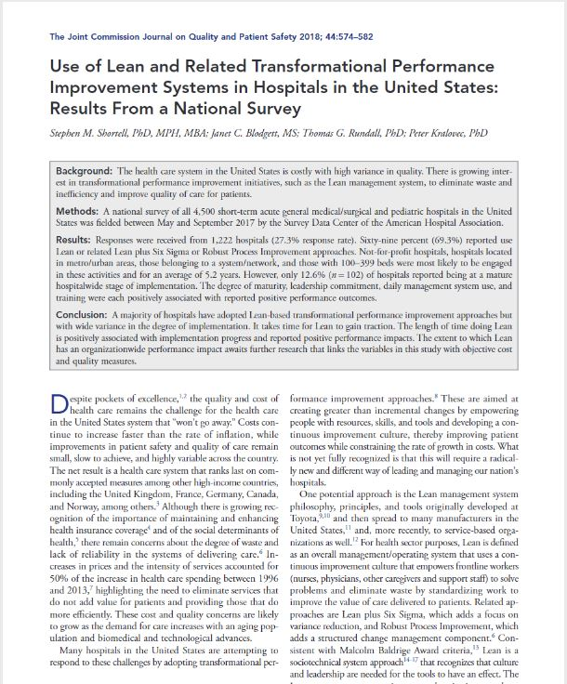
Some Emerging Evidence – Large Scale Studies

Slide 20
Central Thesis
The Greater the Degree of Lean Implementation, the Better Hospital Performance (Cost and Quality)

Slide 21
Methods
National Survey of 4500 Hospitals
Acute Care Medical and Pediatric General Hospitals
Survey Questions Based on Comprehensive Literature Review of Lean Philosophy, Principles, and Practices
Pilot Testing
20 Minutes Online
N = 1222 Hospitals (27% Response Rate)
Small but Statistically Significant Differences by Ownership, Teaching Hospitals, Region, and Bed Size

Slide 22
Basic Results
69.3% Report Doing Lean, Lean Plus Six Sigma, or robust Process Improvement
Adjusted Adoption Rate 61.6%
Only 12.6% (N = 102) at a Mature Hospital-Wide Stage

Slide 23
Summary of Findings
Degree of Lean Implementation was Positively Associated with Self-Reported Performance Outcomes
Adoption of Lean was Positively Associated with Some Independent, Objective Performance Measures
Lower Risk Adjusted Medicare Spending per Beneficiary
Lower Pressure Ulcer Rate
Lower 30 day Unplanned Readmission Rate

Slide 24
Overall Conclusions
Majority of U.S hospitals are doing some LEAN or related transformational improvement approaches
A relatively small number are “mature” - spread throughout the organization with some depth
It takes time - 2 to 5 years - to begin to take hold; longer to spread more widely
Top leadership commitment, daily management system and training are key to standardize work
Encouraging results - hospitals doing lean have better cost and quality performance on some key indicators than those not doing LEAN

Slide 25
The Challenge
A Comprehensive New Way of Leading and Managing Our Nation’s Health Care Organizations May Be Needed For Sustainable Transformational Improvement And To Increase The Organizational Capacity To Address Wicked Problems – Such As The Coming Future Pandemics

Slide 26
High Priority Rapid Cycle Research Priorities
Covid-19 as a Natural Experiment
Patient and Community Impact and Experience
Care Delivery, Management, and Operations
Workforce
Technology, Data, Telehealth
Payment and Regulations
Collaboration and Coordination
Source: Academy Health Paradigm Project, May, 2020

Slide 27
It Is Unfortunate That It Has Taken A Pandemic On The Scale Of Covid-19 To Accelerate The Changes And Learning Needed To Improve The Way Healthcare Is Delivered In The United States.
“Never Waste A Crisis”

Slide 28
Thank You!
For more information see:
www.choir.berkeley.edu
www.clear.Berkeley.edu
shortell@berkeley.edu
Your Questions
Notes:
28

