Slide 1
Cultural Perspectives Faculty Forum
AUPHA Annual Meeting
July 24, 2020

Slide 2
Agenda
Purpose and History of Cultural Perspectives Faculty Forum
Announcement of New Forum Leadership
Recap of 2020 AUPHA Annual Meeting Sessions Related to Diversity, Inclusion, and Equity
How Cultural Perspectives Forum Can Inform and Enhance the DEI Efforts of AUPHA Members
Possible Forum Projects

Slide 3
Purpose and History of Cultural Perspectives Forum
Mission of the forum
History of the forum
Diversity Committee created in early 2000’s
1940
1950
1960
1970
1980
1990
2000
2010
2020
First Formal meeting of AUPHA in May, 1949
Diversity Forum started in 2008

Slide 4
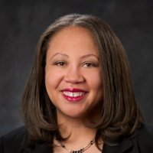
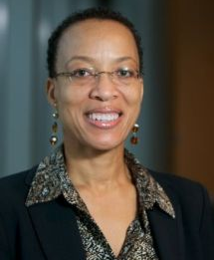
Forum Leadership
Dale Sanders concludes term as Forum Chair
Lumbé Davis and Jaqueline Wiltshire transitioning on as Chair and Vice-Chair

Slide 5
DEI Highlights from 2020 AUPHA Annual Meeting
Undergraduate Track Session: Bridging Diversity Gaps in Health Care
Keynote Address: Health Equity: Moving Beyond the Legacy of Racism and Discrimination
Panel Discussion: Racism, Social Injustice, and Discrimination: How can Health Administration Education Make a Difference

Slide 6
Discussion Questions
“Current environment is very unsafe for whites to attempt to have discussion with legitimate questions, let alone criticisms.”

Slide 7
Possible Forum Projects
Collaboration on a Case with Inter-Professional Education (IPE) Forum
Toolkit to Address DEI Issues in the Classroom
Develop an Online DEI Course

Slide 8
Thank You!

