Slide 1
Margaret McAlister
Joey Helton

Slide 2
Bridging the Gap of Diversity
Why is addressing the diversity gap important?
In healthcare, it is particularly critical to ensure decision makers better reflect and represent the diversity of the patient populations they’re serving.
Apart from promoting a positive work culture, cultivating inclusion supports the bottom line.

Slide 3
Without a Diverse Work Environment
Limited perspective
Limited operating structure
Lack of communication
Limited direction
Limited growth potential

Slide 4
Overcoming Diversity Challenges
Get personally involved
Conduct a self-assessment.
Apply and use your results
Adjust and seek to be more
diverse in thinking and actions.

Slide 5
Overcoming Challenges with Diversity
Work on Diversity one obstacle at a time.
Little things can be a help or a deterrent..

Slide 6
What can we do to Bridge the Gap?
Encourage sponsorship and advocacy at all levels.
Make a concerted effort to listen to and include all voices.
Create mentorship opportunities.
Put diverse voices front and center.

Slide 7
Without planning it could be a dangerous crossing.
Minimize the risk with planning and training.

Slide 8
Bridging the Gap
The bridge begins at the top of the organization
Provide opportunities
.
to experience growth and create
experiences that nurture a diverse environment.

Slide 9
What did you discover?

Slide 10
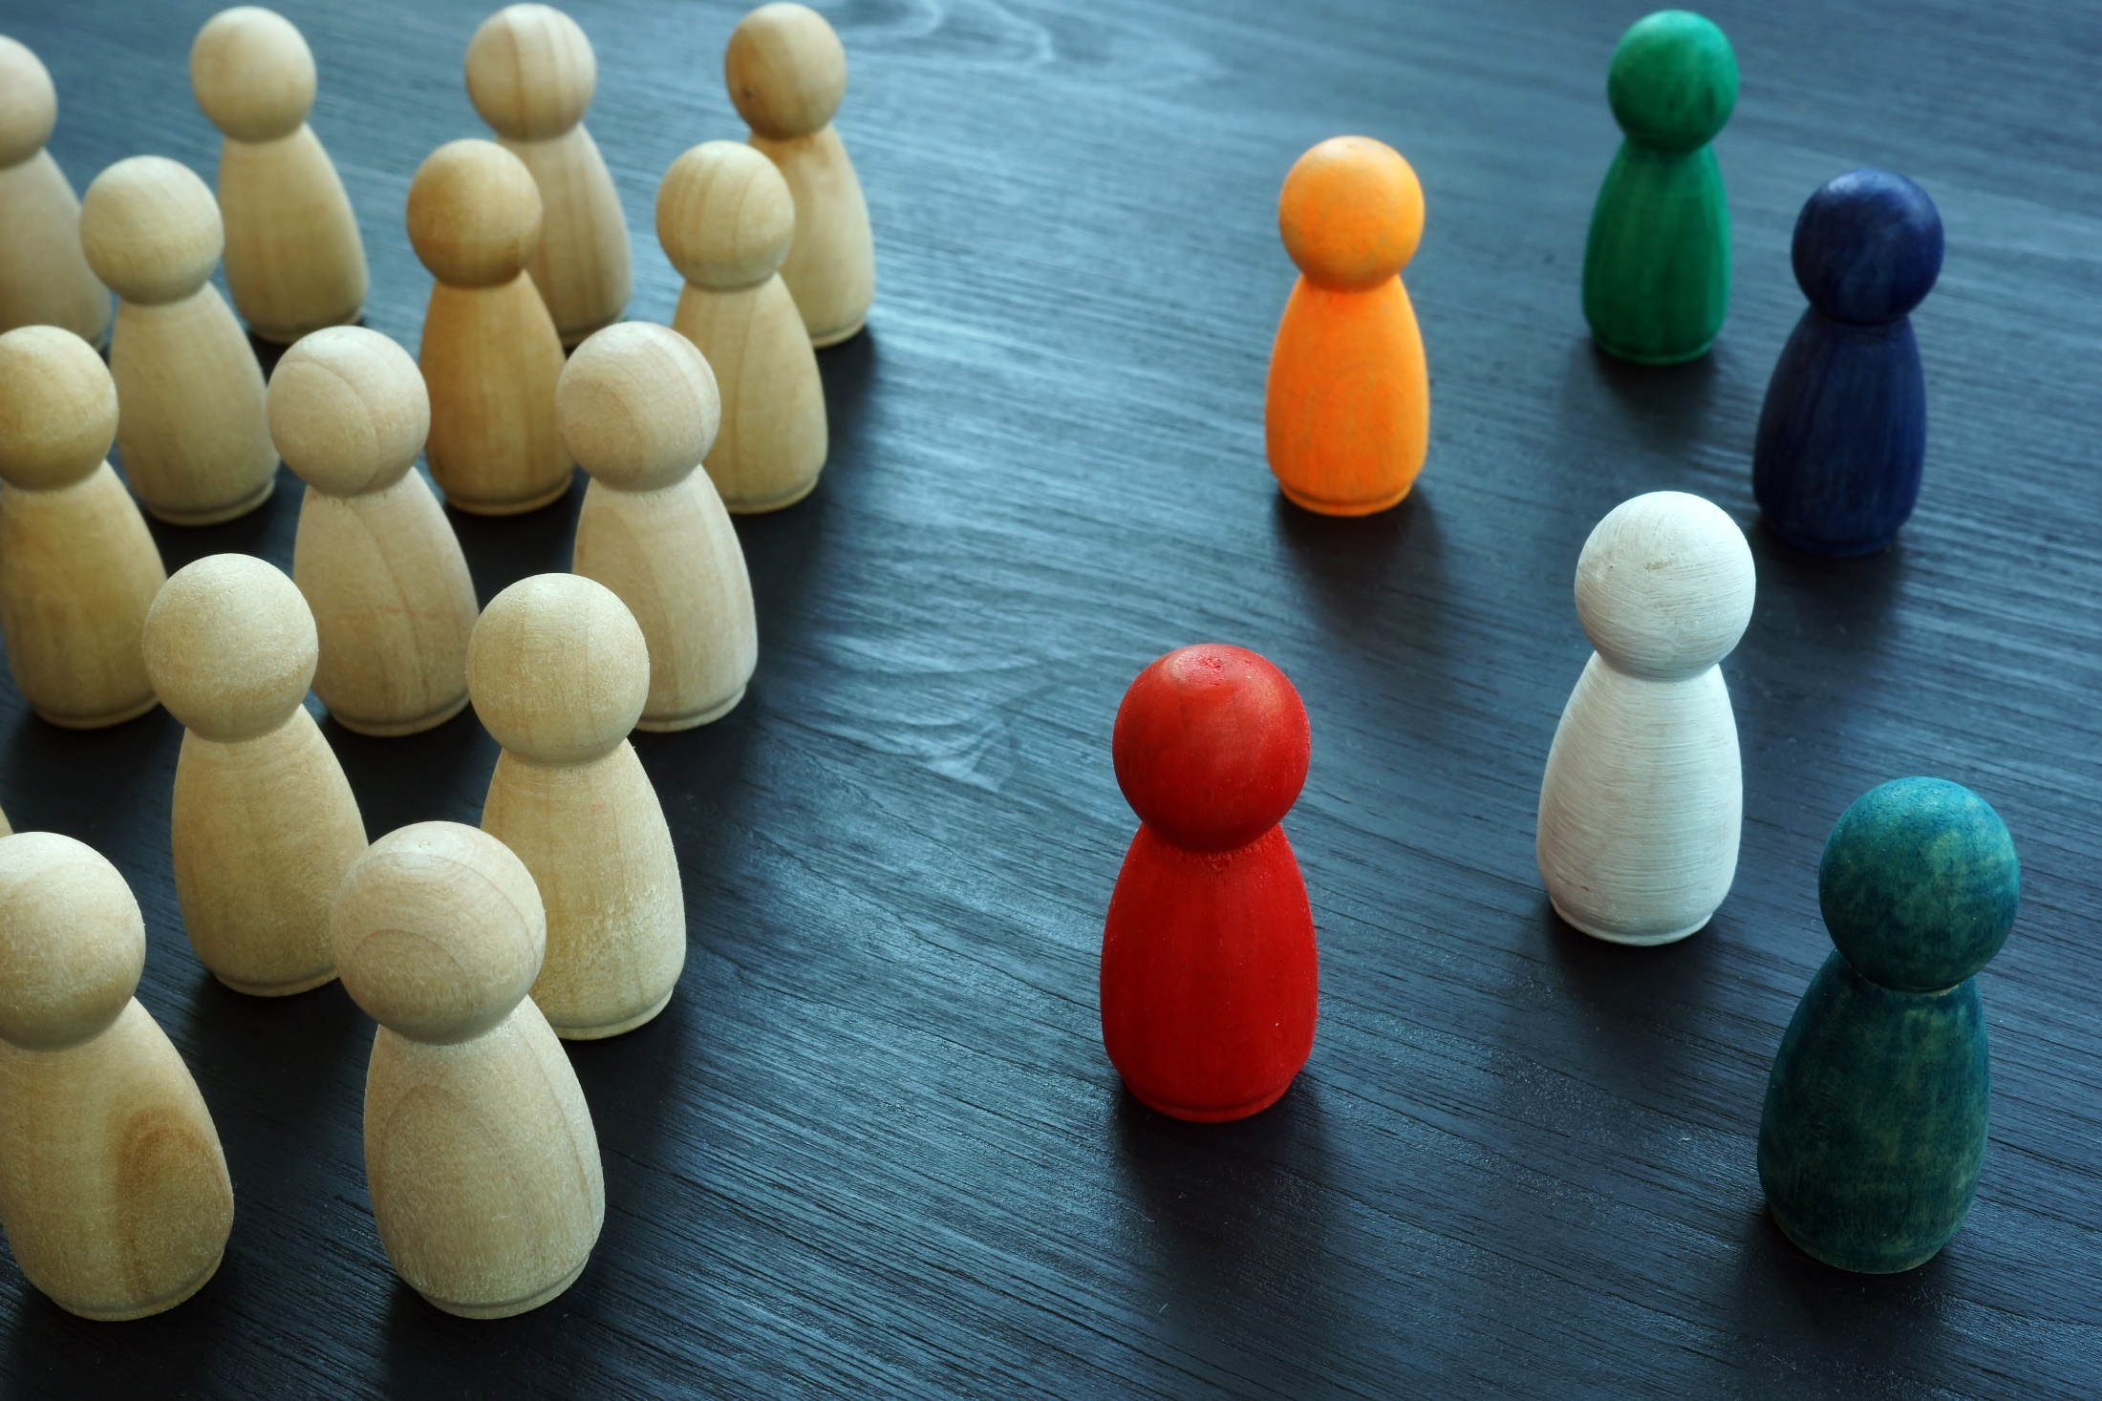
Self analysis activity
How Diverse is Your Universe ?

Slide 11
Blue – Hispanic Latino Yellow – Black or African American Purple – Asian Red – Caucasian White Green - Other

Slide 12
Select a bead that most closely represents your race/ethnicity.
Select a bead that most closely represents the race of your significant other.
Select a bead that represents the race of your closest friend.
The race of the people with whom I worship are predominately…
My neighbors (at home) on either side of my house are…

Slide 13
6. My doctor is…
7. My dentist is…
8. My lawyer/attorney is…
9. My boss is…
10. My co-workers are predominately…
11. The people in my social circle are predominately…
12. The author of the last book I read was…

Slide 14
13. In the last good movie I saw, the people were predominately…
14. The people in my favorite TV show are predominately…
15. During the course of a day, the people with whom I come into contact are predominately…
16. The person who I most admire or who has had the greatest impact on my life is…
17. The people in my favorite music group or band are predominately…

Slide 15
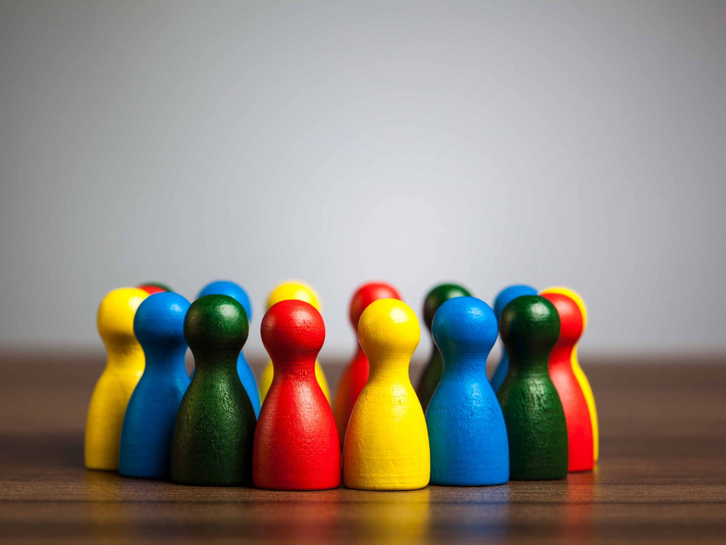
How did you do?

Slide 16
Reflect on what your universe looks like.
Is it a good thing?
Is it dominated by one group of people? If yes, why?
How can you change that?
Why is it important to work with and live with a variety of people that are different from you?
How could you apply this to your life?
How will this change your daily viewpoint?

Slide 17
What we have experienced
3 students said this activity would not change them to become more diverse.
One comment was "As simple as this activity was, it was very thought provoking and eye-opening, increasing diversity is going to be my personal challenge to myself."
Another was "I applied this to my life (diversity) by travelling and studying abroad."

Slide 18
HOSPITAL
The gap can be bridged!

