Slide 1
Global Response of Programs in Health Administration to the COVID-19 Pandemic:
Interpretation, Implications, & Action
September 21, 2021
Rev. 9/20/2021
Notes:
[Jason]
Hi everyone, welcome to today’s session – Global Response of Programs in Health Administration Education to the COVID-19 Pandemic: Interpretation, Implications, & Action. We are going to examine the results of a survey of graduate programs in the US, Canada, and around the globe conducted by CAHME, in coordination with AUPHA, the European Health Management Association, and the International Hospital Federation.
This session is co-hosted by the Commission on Accreditation of Healthcare Management Education (CAHME), and Association of University Programs in Health Administration (AUPHA).

Slide 2
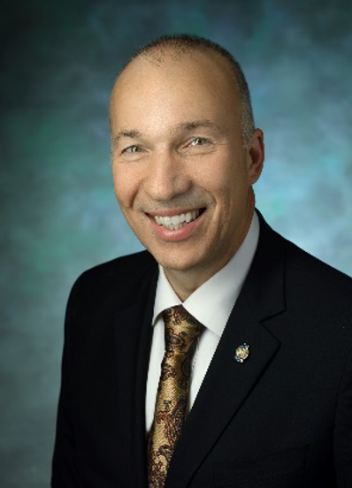
Our Hosts
Anthony Stanowski, DHA
President & CEO Commission on Accreditation of
Healthcare Management Education
Philadelphia, PA, USA
Daniel Gentry, PhD, MHA
President & CEO Association of University Programs
In Health Administration
Washington DC, USA
2
Notes:
[Jason]
And now, let me welcome our two hosts, Anthony Stanowski, President and CEO of the Commission on Accreditation of Healthcare Management Education, and Daniel Gentry, President & CEO, Association of University Programs In Health Administration.

Slide 3
Mission and Values
Our mission is to serve the public interest by advancing the quality of healthcare management education globally by:
Setting measurable criteria for excellent healthcare management education
Supporting, assisting and advising programs which seek to meet or exceed the criteria and continuously improve
Accrediting graduate programs that meet or exceed the criteria
Making this information easily available to interested constituencies
Our values include:
Integrity
Excellence
Transparency
Fairness
Recognition
Our mission is to foster excellence and innovation in health management and policy education, and scholarship.
Our values include:
Excellence: AUPHA believes that excellence in education leads to excellence in healthcare management practice, and ultimately leads to improved quality, efficiency and accessibility in healthcare delivery.
Innovation: AUPHA promotes innovation, encourages the adoption of new strategies, and disseminates best practices in healthcare management and policy education.
Collaboration: AUPHA collaborates in the generation and translation of research and the integration of theory and practice in interprofessional work environments.
Diversity: AUPHA believes diversity in people, in programs and in perspectives is essential for an effective interprofessional workforce.
Learning: AUPHA pursues continual learning to advance and share knowledge, to foster the development of pedagogy, and to improve teaching and practice.
3
Notes:
[Anthony does CAHME; Dan does AUPHA on next slide]
Our mission at CAHME is to serve the public interest by advancing the quality of healthcare management education globally by:
• Setting measurable criteria for excellent healthcare management education • Supporting, assisting and advising programs which seek to meet or exceed the criteria and continuously improve • Accrediting graduate programs that meet or exceed the criteria • Making this information easily available to interested constituencies

Slide 4
Mission and Values
Our mission is to serve the public interest by advancing the quality of healthcare management education globally by:
Setting measurable criteria for excellent healthcare management education
Supporting, assisting and advising programs which seek to meet or exceed the criteria and continuously improve
Accrediting graduate programs that meet or exceed the criteria
Making this information easily available to interested constituencies
Our values include:
Integrity
Excellence
Transparency
Fairness
Recognition
Our mission is to foster excellence and innovation in health management and policy education, and scholarship.
Our values include:
Excellence: AUPHA believes that excellence in education leads to excellence in healthcare management practice, and ultimately leads to improved quality, efficiency and accessibility in healthcare delivery.
Innovation: AUPHA promotes innovation, encourages the adoption of new strategies, and disseminates best practices in healthcare management and policy education.
Collaboration: AUPHA collaborates in the generation and translation of research and the integration of theory and practice in interprofessional work environments.
Diversity: AUPHA believes diversity in people, in programs and in perspectives is essential for an effective interprofessional workforce.
Learning: AUPHA pursues continual learning to advance and share knowledge, to foster the development of pedagogy, and to improve teaching and practice.
4
Notes:
[Dan Gentry]
Our mission at AUPHA is to foster excellence and innovation in health management and policy education, and scholarship.
Our values include:
Excellence: AUPHA believes that excellence in education leads to excellence in healthcare management practice, and ultimately leads to improved quality, efficiency and accessibility in healthcare delivery.
Innovation: AUPHA promotes innovation, encourages the adoption of new strategies, and disseminates best practices in healthcare management and policy education.
Collaboration: AUPHA collaborates in the generation and translation of research and the integration of theory and practice in interprofessional work environments.
Diversity: AUPHA believes diversity in people, in programs and in perspectives is essential for an effective interprofessional workforce.
Learning: AUPHA pursues continual learning to advance and share knowledge, to foster the development of pedagogy, and to improve teaching and practice.

Slide 5
Why did we do this?
5
Notes:
[Dan Gentry]
So the question…why conduct this survey. Well, we wanted to understand the implications of COVID-19 on graduate healthcare management education.

Slide 6
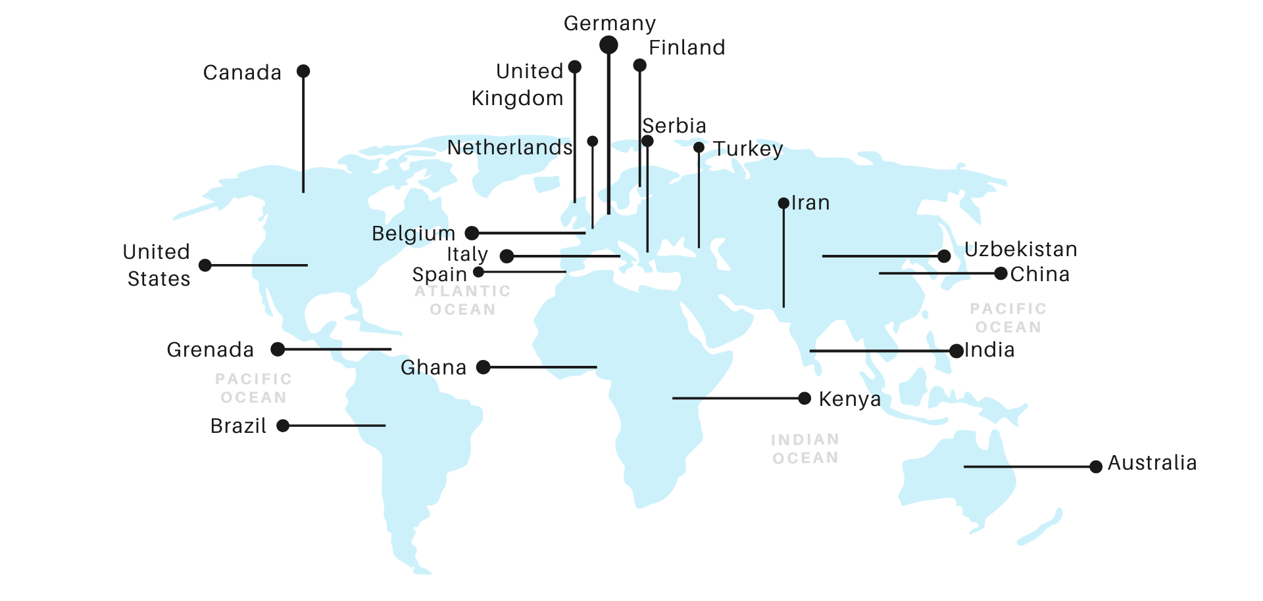
The responses came from around the globe.
6
Notes:
[Anthony]
We created a six-question survey to evaluate impacts of the COVID-19 pandemic on healthcare management education globally. In total, during the month of March 2021, we received 229 responses (83% from the US), representing 150 Universities, from healthcare management programs around the globe.
CAHME surveyed accredited programs in the US and Canada, and we scanned the web to add additional university programs in healthcare management across the globe. AUPHA provided a list of members to survey, and EHMA also participated in promoting and administering the survey to their members.
This image depicts the countries where we received responses. Now listen…the goal is NOT statistical significance…we just wanted to take the rough pulse of where things are in academia around the globe.
And to guide our understanding, we assembled a panel of leading academics.

Slide 7
Reaction Panel
Daniel J. West, PhD
Chairman & Professor
University of Scranton
Scranton, USA
Nancy Borkowski, MS, DBA
Distinguished Professor
University of Alabama at Birmingham
Alabama, USA
Steven Howard, PhD Associate Professor
Saint Louis University
Missouri, USA
7
Notes:
[Dan Gentry Introduces Panel] (individual slides for each panelist appear on next slides)
Today we have Dan West (Chair of CAHME’s Global Advisory Council), Nancy Borkowski (Chair of the AUPHA Board’s Global Health Leadership Committee), and Steven Howard (Chair of the AUPHA Global Healthcare Management Faculty Forum).

Slide 8
Global Experts
Daniel J. West, PhD
Chairman & Professor
University of Scranton
Scranton, USA
Nancy Borkowski, MS, DBA
Distinguished Professor
University of Alabama at Birmingham
Alabama, USA
Steven Howard, PhD Associate Professor
Saint Louis University
Missouri, USA
8
Notes:
[Dan West Introduction]
Daniel J. West, PhD, FACHE, is the Chairman and Professor in the Department of Health Administration and Human Resources at the University of Scranton. He has specialized in international health care, globalization, multiculturalism, and diversity management. Dan is the chair of CAHME’s Global Advisory Council.

Slide 9
Global Experts
Daniel J. West, PhD
Chairman & Professor
University of Scranton
Scranton, USA
Nancy Borkowski, MS, DBA
Distinguished Professor
University of Alabama at Birmingham
Alabama, USA
Steven Howard, PhD Associate Professor
Saint Louis University
Missouri, USA
9
Notes:
[Nancy Borkowski Introduction]
Nancy Borkowski, DBA, CPA, FACHE, FHFMA is a Distinguished Professor in the Department of Health Services Administration at the University of Alabama at Birmingham. Nancy has over 20 years of experience in the healthcare industry and is a two-time past recipient of the American College of Healthcare Executive’s (ACHE) Southern Florida Senior Career Healthcare Executive Award, which recognizes individuals who have made significant contributions to the advancement of health management excellence.

Slide 10
Global Experts
Daniel J. West, PhD
Chairman & Professor
University of Scranton
Scranton, USA
Nancy Borkowski, MS, DBA
Distinguished Professor
University of Alabama at Birmingham
Alabama, USA
Steven Howard, PhD Associate Professor
Saint Louis University
Missouri, USA
10
Notes:
[Steven Howard Introduction]
Steven has been at SLU for 10 years and teaches Marketing, Strategy and Managed Care. He is a Health Services Researcher with interests in value-based care, healthcare delivery and payment innovation, and chronic disease, particularly in how those issues transcend borders. Steven chairs the AUPHA Global Healthcare Management Forum, and is actively researching innovations in healthcare payment models in Europe and the US (in fact, he is Zooming in from the Netherlands where is currently on research sabbatical).”

Slide 11
Worldwide, critical thinking & analysis, and leadership/management were considered the most important competencies in the pandemic.
Most Important Competency Domains
11
Notes:
[Dan Gentry]
One question from the survey discussed the critical competencies for healthcare leaders during the pandemic. Critical thinking & analysis, and leadership/management were considered the important competencies in the pandemic. Communications was also considered as an essential competency for leadership/management in the pandemic.
Dan West, from your perspective what competencies were essential for students during the pandemic?
(Dan West to provide response)

Slide 12
Pre-pandemic, 59% of programs were traditional face-to-face. Post-pandemic, programs expect to be evenly split between modalities.
Pre-Pandemic
Pandemic
Post-Pandemic
12
Notes:
[Anthony]
The survey revealed that we also saw a change in the way students were educated. Pre-pandemic most programs surveyed, 59%, reported being face-to-face. Hybrid programs were in the minority, with only 17% reporting part of the class being virtual and part being face to face. 24% were mostly on-line programs.
Of course, during the Pandemic, most programs went totally virtual…87%, with only 11% being hybrid. Almost none were face-to-face.
However, the expectation post pandemic is that totally face-to-face will not regain its leadership role. Only 33% of programs will go back to mostly face-to-face. The percent that will be staying all virtual will roughly return to pre-pandemic levels at 28%. However, 40% of programs will be a hybrid.
Now…here is an argument. Rather than “poor students”, they didn’t get the education that they needed…some might say, lucky students, they got an even better education…one that tested not just their ability to gain knowledge, but challenged their whole way of learning that will be essential in the post-pandemic world.
So, Nancy, what do you see as being the most significant impact of this change? With the move to more online content vs. in-person, does this represent a different way that students will get their education? What are the implications? (Nancy provides response)

Slide 13
58% of Programs were Challenged in Placing Students in Real-World Experiences.
13
Notes:
[Anthony]
Thanks, Nancy. Steve, I’d like to focus next on the “real world” experiences of students a little more. The survey shows that academic programs went through a period with challenges in placing student in experiential learning situations (whatever we define “real world” to be….We saw that 58% of programs were challenged in placing students in real-world experiences.
Steve … one of the cool parts that I heard from programs was how students found other experiences working remotely. Can you comment on what the SLU program did to provide experiences to students?
(Steve responds on next slide)

Slide 14
Pandemic Challenges for Internship Placement & Integrative, Real-World Experiences
Internships & Residencies: What did SLU & others do?
Traditional IRL / F2F
Traditional, but Virtual
Non-traditional experiences:
Unpaid projects for industry partners & alumni
Projects with faculty (applied research)
Other class & capstone experiences?
Most projects already hybrid/virtual
Some hosts/clients too busy w/ pandemic response
14
Notes:
Steven Howard:
-SLU- examples of traditional IRL / F2F internships that went forward (like Houston Methodist and other health systems)
-SLU- examples of ones that went forward, but all on Zoom / virtual-synch. / virtual-asynch. (BCBS, CareRev, MedStar…)
-SLU- examples like CareRev where alumni who had never done so before stepped up to take multiple interns, all virtual.
-SLU- examples of faculty or alumni-led independent studies / applied research projects and whether/how those hours were counted.
-SLU- added Essential Skills virtual workshops to improve students’ professionalism in virtual work world.
-Baylor- >half their residencies became unpaid, espec. Health system sites… other/non-tradl sites paid.
-Baylor- students at unpaid sites rec’d some $$ from Dept. funds.
-Baylor- alumni and speaker sessions went virtual.
-MUSC- increased alumni mentorship of students (virtual).
- ALSO, discuss class projects / capstones.

Slide 15
Worldwide 31% of programs decreased students in their program, 44% stayed the same, and 25% increased.
15
Notes:
[Dan Gentry]
Worldwide 31% of programs decreased students in their program, 44% stayed the same, and 25% increased.
[Dan Gentry to discuss some perspective on AUPHA and what it saw]. [Dan asks]:
Any additions from the other attendees?
Do you think this decrease will impact the quality and number of people that go on to lead healthcare organizations?
What can leading academics do to address these fluctuations?
(Panel addresses issues)

Slide 16
Questions?
16
Notes:
[Dan] Thank you panelists. We have about ___ minutes for questions. If you have questions for our panelists today, please type them in the chat or raise your hand and we will open the microphone up.
(Stop 1-2 minutes before the hour)
Closing remarks:
[Dan] Thank you all for attending today.
Thank you, Dan (West), Nancy, and Steve for this informative session.

