Slide 1
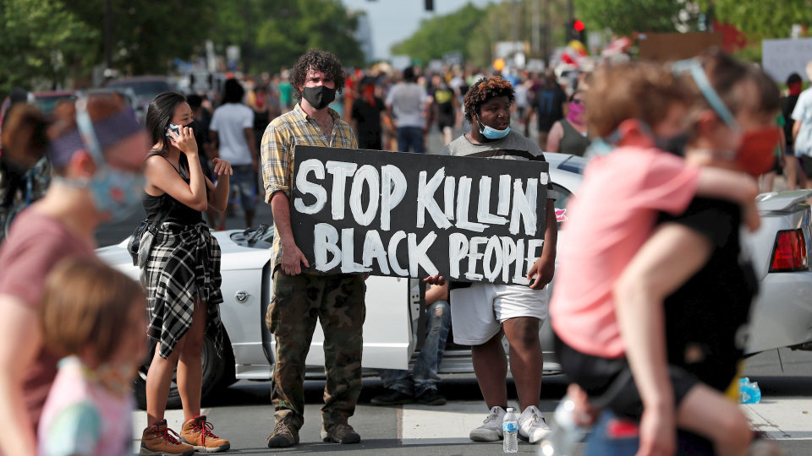
Source: https://www.wsj.com/articles/fbi-minnesota-authorities-probe-death-of-black-man-in-minneapolis-police-custody-11590506499

Slide 2
How can Health Administration Education Make a Difference?
Systems Thinking
Interconnectedness (everything is interconnected)
Synthesis (combining two or more things to create something new)
Emergence (natural outcome of things coming together)
Feedback Loops (loops and flows between elements of a system)
Causality (how one thing results in another in a dynamic system)
Systems Mapping (map ‘things’ within a system to understand how they interconnect)

